Slide 1
RIRINSE – RIR Internet Number Sources Explained
5th APNIC Hackathon, 25 - 26 February 2024

Slide 2
Introductions
Sainaa - Intro
Amanda - Why
Alin – What & How
Shankar Ganesh – Challenges
Future Direction

Slide 3
WHY
Hard to find information: There's too much scattered information and no complete list of available data, making it difficult for people and computers to use. Difficult to track resources: It's hard to see where resources are assigned, sold, used, etc.
Time zone issues: Combining data from different regions with different time zones is challenging.
For Example: IP block bought in Ireland but used in Thailand. Information isn't connected: Data from different sources isn't linked, making it hard to understand the full picture.

Slide 4


What
Consumers
Make a catalog of all the services under APNIC as an RIR.
Find all the Documentation for the services, and API endpoints and link it with service name with easy to understand description for Humans.
Also find or build all the YAML files for all the API endpoints and link to the services in the catalog so that Programs can read it.

Slide 5
How
Find all the service name and initiate the building blocks
Bring in the already existing documentation, API endpoints, and YAML files, example codes and link them in separate columns.
If they are not available create them and link them in the catalog.
Use LLM to read the API results and create YAML file for them.
Get more details regarding all endpoints from the RIRs internal software team.

Slide 6
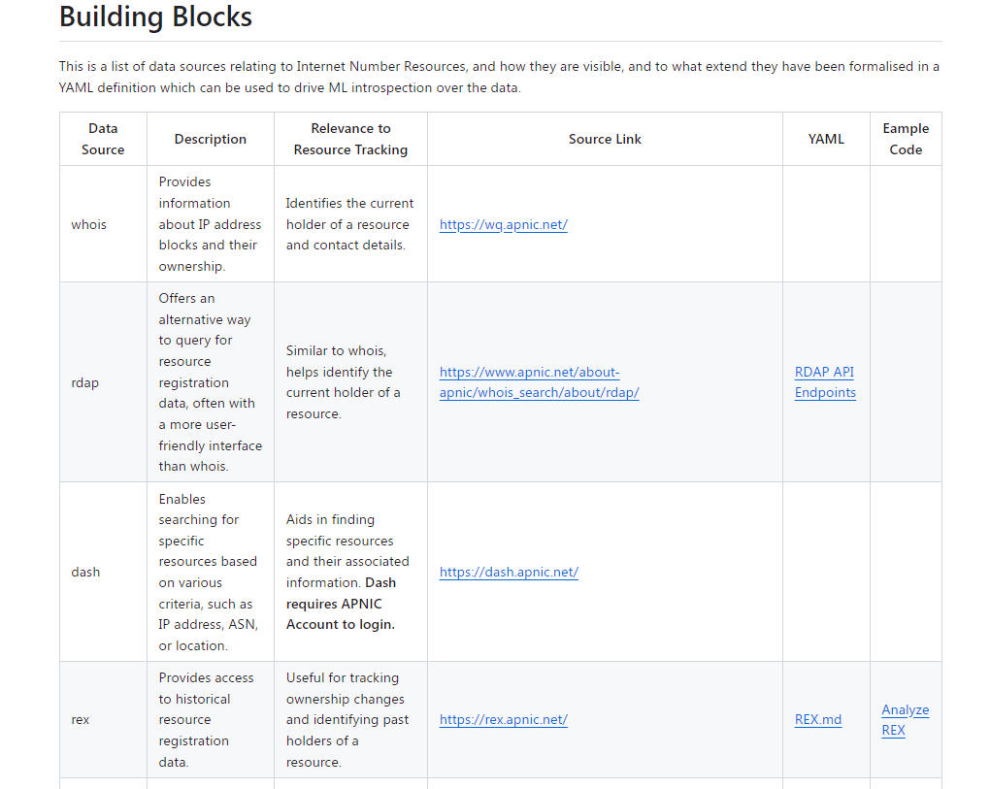
Outcomes
https://github.com/datalin/RIRINSE-APNIC57/tree/main/Building%20Blocks
https://github.com/datalin/RIRINSE-APNIC57/tree/main/Example-Code

Slide 7
Challenges
Found it hard to read the RFCs, used LLM to read the RFC and generate YAML but that was not working always.
Not all documentation has all the endpoint mentioned, so we had to collect endpoints and add.
We could write the code to fetch, but because of the lack of documentation already, we couldn't analyze the data properly for NRO.

Slide 8
Future Work
Complete the YAML and example code of all the mentioned services of APNIC
Find more services under APNIC as an RIR
Do this same documentation for all the other RIRs
Be more detailed in explaining what the service provide as data and how to call the service, in terms of human readable language and YAML

Slide 9
References
https://github.com/datalin/RIRINSE-APNIC57
https://datatracker.ietf.org/doc/draft-ellacott-historical-rdap/
https://datatracker.ietf.org/doc/rfc8805/
https://datatracker.ietf.org/doc/html/rfc7482
https://datatracker.ietf.org/doc/html/rfc7483
https://rex.apnic.net/
https://www.geeksforgeeks.org/introduction-to-explainable-aixai-using-lime/
https://gemini.google.com/ & https://chat.openai.com/

